Slide 1
TWEET US @AHA_SLHQ #QualityRoadmap
Notes:
Resting slide

Slide 2
The Role of Patient and Family Engagement in a High Reliability Organization
Moderator: Bev Johnson
President and CEO, Institute for Patient
and Family Centered Care (IPFCC)
Panelists: Mark Rumans, MD
Chief Medical Officer, Vidant Health
Dorothea Handron
Patient/Family Advisor, Vidant Health
Mary Cooper, MD
Vice President and Chief Quality Officer, Connecticut Hospital Association

Slide 3
2014 Quality & Patient Safety Roadmap
Engaging Patients and Families in Quality and Safety Performance Improvement
Mark Rumans, MD, MMM, CMO
Dorothea Handron, APRN, EdD, Advisor
Vidant Health, Greenville, North Carolina

Slide 4
Objectives
Discuss critical success factors in advancing a culture of patient-family engagement.
Identify the value of and best practices for partnering with patient and family advisors to achieve optimal outcomes, exceptional experiences in care and zero events of preventable harm.

Slide 5
A Day in the Life of Vidant Health
196 acute care admissions
136 surgeries
118 critical care patients
822 ED visits
1,377 outpatient visits
2,000 physician practice visits
7 air medical transports
21 newborn deliveries
184 patients with central lines
78 patients on ventilators
144 patients with urinary catheters
55 patients receiving hospice
500 patients receiving home health

Slide 6
“Alone we can do so little,
together we can do so
much.” Helen Keller

Slide 7
A Journey Through 91 Days
“Routine Hernia Repair”
Rocky Road
Serious Safety Events
Healing and Recovery

Slide 8
Patient-Family Advisor Roles: Bedside to Board Room
Purposeful Rounding - bedside report, hourly rounds
Storytelling and Education - Board presentations, videos, staff meetings, conferences, resident and employee orientation
Quality teams - Falls with harm, CAUTI, Pressure Ulcer Prevention, VAP, CLABSI, Hand Hygiene, Pain, long-range planning
Review of patient materials
Safety - safety summit, safety rounds, RCA teams
Facility Design - all patient facing construction and renovations
Patient Portal Development and Enhancements
Care Coordination
Advisors to Board

Slide 9
Lessons Learned – Leadership Matters
“A leader leads by example, whether he intends to or not.”
Author Unknown
Notes:
Get leaders involved and committed early

Slide 10
Lessons Learned – Integrate Into Existing Work
Healing Without Harm
Don’t Hurt Me, Heal Me, & Partner with Me
Will
Reliability Science
Knowledge and understanding of human error and
human performance in complex systems
Design of
Work
Processes
Lean, Six Sigma
Design of
Culture
Safety Habits , Team Work, Engaging pts as Partners
Design of
Policies &
Protocols
Focus & Simplify
Ideas
Design of
Technology & Environment
Electronic medical record,
barcode technology,
smart pumps
Design of
Structure
Hourly Rounding, BSSR
Leadership
Reinforce & Build Accountability
for performance expectations and
Find & Fix system problems
Execution
Behaviors
of Individuals & Groups
Exceptional Outcomes
Healthcare That Is Safe – Zero Events of Harm
Timely, Effective, Efficient, Equitable & Patient Centered
© 2009 Healthcare Performance Improvement, LLC. ALL RIGHTS RESERVED.
Notes:
Build on existing work – don’t reinvent the wheel
A & B
B
A
B
A

Slide 11
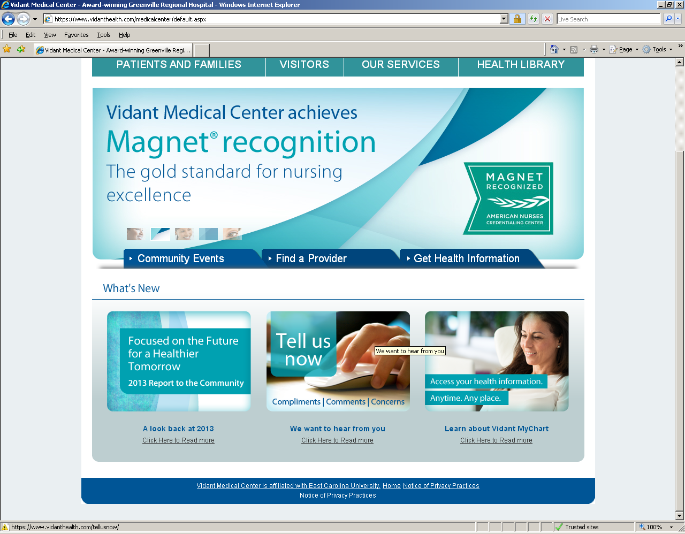
Lessons Learned - Transparency is Powerful

Slide 12
Lessons Learned: It Takes Time
System policies, structure implemented
Integrate Patient Education
Established Corporate office Patient Experience
AMC established Office of Patient and Family Experience
Advisor councils at hospitals; AMC service lines; PCMH clinics
Patient Engagement in clinical strategy
Institute of PFCC CEO site visit
Completed PFCC hospital self-assessments
Executive
staff attended IPFCC training
Annual Board Retreat - Dr. Jim Reinertsen
Annual Board Retreat-Jim Conway
Advisors on existing teams/committees
Standardize language access services
UHC 2006 PFCC Project
2000-2006
2007
2008
2009-2010
2011-2013
2014 and beyond
AMC developed Advisor Roles in Children’s and Rehab
System 5-year Quality plan includes PFCC
Patient shares story with Board Quality Committee (QIC)
Board Quality Committee plan includes patient stories
Advisors on RCA teams
Strategic framework and Board scorecard included patient experience focus
Full integration of advisors on existing teams and committees
Presidents share patient stories with Board
Advisor on Corp. and AMC Board QIC
CFO engagement
Advisor on Board QIC
Identify PFE staff champions
PFCC curriculum developed with advisors
Identify entity PFE leaders*
Notes:
It takes time to change culture – never underestimate the time necessary to effect change
Words matter
No excuses, focus, execute

Slide 13
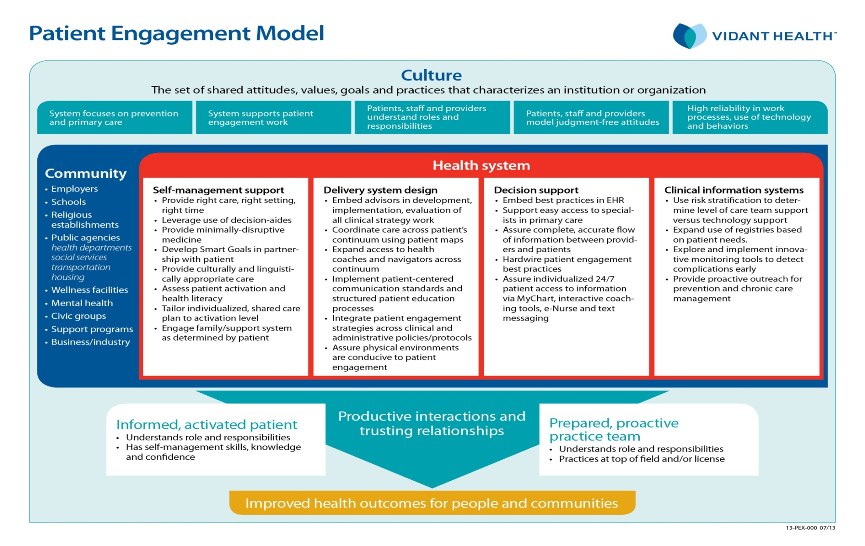
Lessons Learned: A System Approach
Notes:
We’ve adapted Wagners Chronic Care model and embedded reliability principles to outline our patient engagement strategies going forward. This model is driven by our cutlure and recognizes that Vidant Health is one small part of a patient’s larger community. The areas in red are areas that we as a health system can and should work to advance. And at the end of the day, we understand that for us to realize improved health and outcomes for people and communities, we must have productive interactions and trusting relationships between prepared proactive teams and informed, activated patients.

Slide 14
Our Outcomes
Top 20% HCAHPS performance in all dimensions of care
83% reduction of serious safety events
62% reduction in hospital acquired infections
2012 McKesson Quest for Quality Prize Citation of Merit: “Vidant Medical Center epitomizes patient and family-centered care by not only including patients and their families during the care process, but also in all aspects of hospital operations and improvement activities.”
2012 UHC Quality & Accountability Study: Top-ranked performer for patient centeredness
2013 John M. Eisenberg Patient Safety and Quality Award-Local
2013 Magnet recognition
Sigma Theta Tau International Award for Strategic Storytelling

Slide 15
Our Outcomes
Reliably built-in partnership with the people we serve
Best-in-region access
Exceptional experiences
Optimal outcomes
Notes:
We realize to build our system of care to meet the needs of the people we are privileged to serve, we must build in partnership.

Slide 16
What’s Next at Vidant Health
Expand advisor and council roles
Revise patient transition/education processes
Redesign care coordination
Expand patient engagement strategies
Never stop learning

Slide 17
2014 Quality & Patient Safety Roadmap
Patient-Family Engagement
Mary Reich Cooper MD, JD
Chief Quality Officer
Connecticut Hospital Association
Wallingford, CT

Slide 18
Objectives
Describe the Connecticut HRO implementation
Discuss the integration of Patient-Family Engagement
Identify the key success factors for HRO/PFE adoption

Slide 19
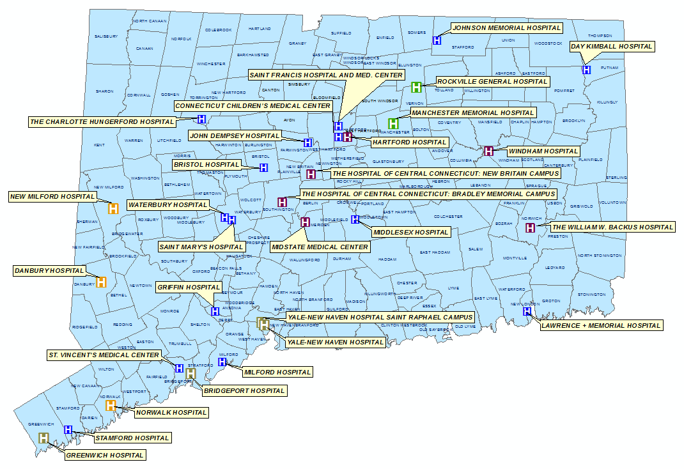
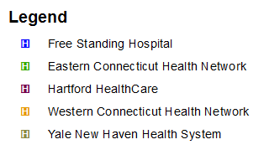
Organizational Profile
If you are with an organization (e.g. staff within a hospital/health care system) - include a few key demographics that are pertinent for the discussion and for the audience to understand about you. These demographics likely impact(ed) your journey to eliminate harm across the board, engage patients, etc.
If you are in a patient advisory role – include a few key demographics of your partner organization (as applicable and or known), as well as a few key highlights of your role, history.

Slide 20
PFE Starts With Me
Safety Starts With Me
“The number one priority for Connecticut hospitals is ensuring patient safety while delivering the highest quality of care.
Patients and their families depend on our hospitals to deliver outstanding care under the safest possible conditions.”
We can’t talk about PFE until we ensure our patients are safe.
20

Slide 21
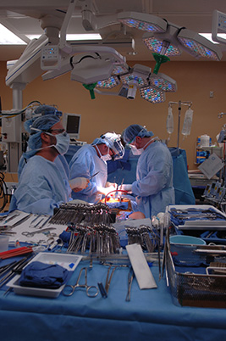
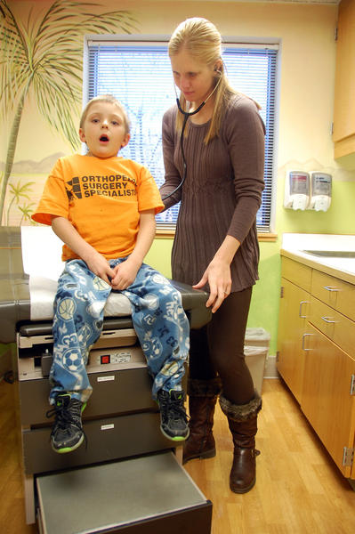
High-Touch Patient Family Engagement
Clear expectations
Consistency
Communication
Comfort
Coordination
Commitment

Slide 22
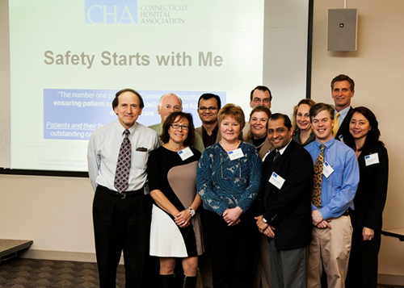
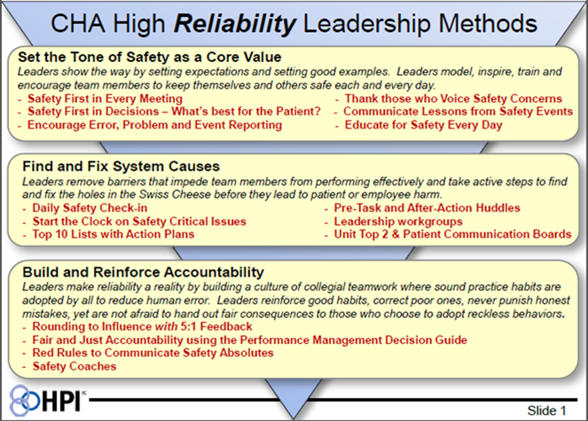
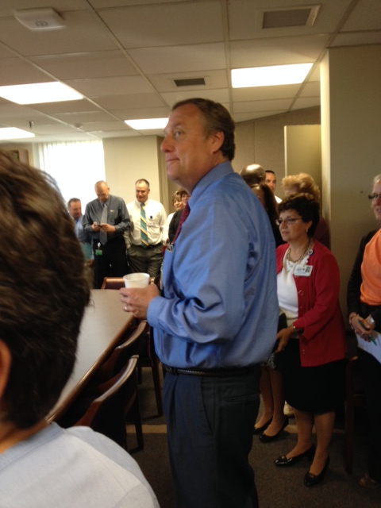
HROs: Leadership
Senior Leader Engagement
Morning Huddles Across
the State

Slide 23
HROs: Endorsing Behaviors
Safety Starts with Me
H
Communicate Clearly
C
Repeat Backs / Read Backs with Clarifying Questions
Phonetic and Numeric Clarifications
H
Handoff Effectively
SBAR
A
Attention to Detail
Self-check using STAR
M
Mentor Each Other – 200% Accountability
Cross-Check and Coach teammates
Speak up for Safety: ARCC it up – “I have a Concern”
P
Practice and Accept a Questioning Attitude
Validate and Verify
Stop the Line – “I need clarity!”
Be a safety “CHAMP” for our patients

Slide 24
TWEET US @AHA_SLHQ #QualityRoadmap
Notes:
Resting slide

