Slide 1



TWEET US @AHA_SLHQ #QualityRoadmap
Notes:
Resting slide

Slide 2
Governance Lessons from High-performing Hospitals
Moderator: Maulik Joshi, DrPH
Senior Vice President, AHA; President, HRET
Panelists: Tammy Dye, MSN, RNC
Vice President of Clinical Officer, Vidant Health
Fred Goldberg, MD
Chief Medical Officer, Nathan Littauer Hospital
Beth Daley Ullem
Patient Advisor and Trustee, Theda Care

Slide 3

2014 Quality & Patient Safety Roadmap
ABCs of High-performance
(Alignment of Board and Community)
Tammy Dye, MSN, RNC
Vice President of Clinical Services and CQO
Schneck Medical Center
Seymour, IN

Slide 4
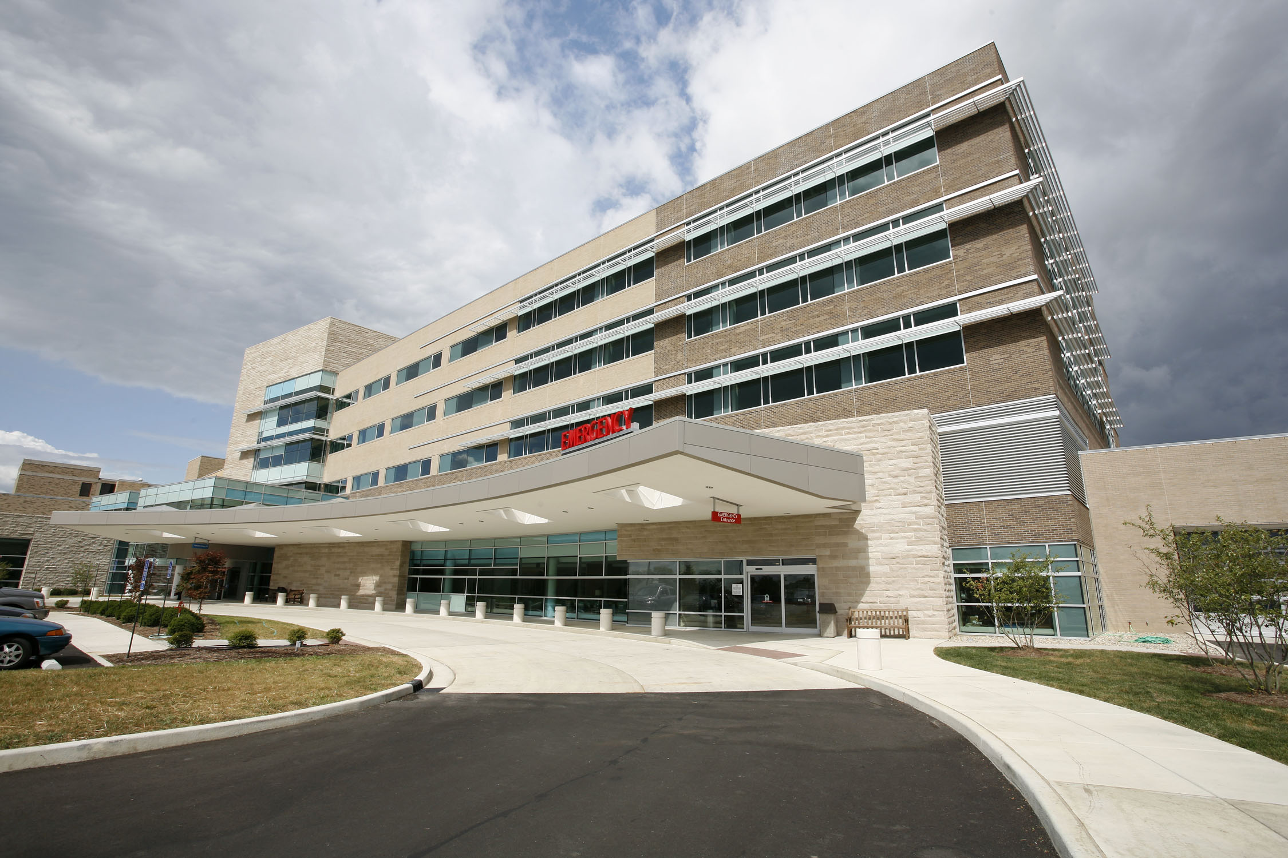

Objectives
Strategies to alignment
Triad of quality
Next steps

Slide 5
Schneck Medical Center
Not-for-profit, county-owned hospital
2011 Malcolm Baldrige National Quality Award Recipient
Facilities include:
  Main campus, 93 all-private suites
  State-of-the-art Cancer Center
  Three Family Care Centers
  Approximately 900 Employees
  Active Physicians (60), 52% hospital employed
  150 Volunteers
Board of Trustees
Nine independent board members
  3 elected government county commissioners
  6 appointed community representatives
  AEC and President of Medical Staff attend board meetings

Slide 6

Alignment Begins With…
Common knowledge & shared vision
  Education
    Routine educational retreats with board members and medical staff
    Ongoing educating BOD, community, and workforce on national changes and impact at a local level
  Communication
    Strategic Planning Process
    Patient Family Advisory Council
    Leadership are active board members on many community programs and committees
Notes:
Educating board on the national changes and the impact at a local level.
Board retreats with medical staff and national speakers
Self assessments.

Slide 7

Triad of Quality
Transparency
Ownership
QUALITY
Innovation
Notes:
Now that we have an educated and aligned the board we use our triad of quality to maintain and strengthen the alignment

Slide 8
Transparency
Strategic Planning
  Everyone is at the table
  Joint dialog with the board, medical staff and community business leaders on their needs and expectations
Results
  Good, bad, and ugly
  Org-wide dashboard on hospital intranet and board portal
  All hospital dashboard and scorecards are in one shared drive for all of leadership to update and review
  Daily Safety Huddles
New!

Slide 9

Ownership – Line of Sight
Strategic initiative in current strategic plan (BOT)
Supported by business plan (VPs)
Implemented through action plans (Directors)
Quality Variance reports submitted quarterly

Slide 10
Innovation
Forming partnerships and collaborations to improve population health
  Industry
  Nursing Homes
Sponsoring 10 RNs to become Nurse Practitioners as additional resources
Hospital physician contracted to long term care facilities as Medical Director supported by NP and CMA
Utilizing Baldrige, Magnet, and Lean Six Sigma to reduce efficiencies and to continuously improve processes and outcomes
Notes:
We empower our staff to look for ways to continuously improve processes including looking for best practices outside of our industry. Many of our recent initiatives include partnering or collaborating with other entities to ensure the continuum of care for our community.

Slide 11
2013 Reducing Readmissions
From 100 per quarter to 40 per quarter
Insert a your “Topic-specific” run chart here, and update this each month. See the example run chart below.
Number Readmissions
Number of Readmissions
11
Notes:
Use the IC to generate.
The denominator for the topic specific measure will be measure specific (not discharges).
11

Slide 12
Successes and Opportunities
Benchmarking with the best and not the average (mean scores)
Looking outside our four walls
  Establishing relationships with LTC facilities
  Collaborating and sharing with other hospitals
Clinical integration with competitor hospital

Slide 13
Next Steps
Ongoing work to improve and sustain outcomes:
  Continuing to build the foundation for clinical integration
  Hardwiring processes
    Developing operational rhythm for departments
      Quality Variance Reports
      Quality Audit Checklist
  Recently created a repository where all department and service line dashboards and quality audit checks will be saved and routinely updated
    Dashboards to include definition page

Slide 14

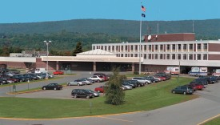
Engaging the Board in Harm Reduction at a
Rural New York State Hospital
Frederick Goldberg, MD
VPMA / Chief Medical Officer
Nathan Littauer Hospital
Gloversville, New York

Slide 15

Objectives
Understand some of the unique features of a small rural community hospital that influence its ability to implement patient safety initiatives.
Be familiar with how best to share patient safety data with the board.
Know the key steps that hospital boards should take to become fully engaged in reducing harm to patients.

Slide 16


Nathan Littauer Hospital
74 bed, rural community hospital in Gloversville, NY at base of Adirondack Mountains
Only acute care hospital in Fulton County
Gloversville, NY

Slide 17




Adirondack Mountains near Gloversville, NY

Slide 18


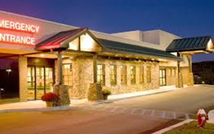
Nathan Littauer Hospital
Active medical staff of 150 (50 % employed)
Full range of acute care services
24,000 annual emergency room visits

Slide 19




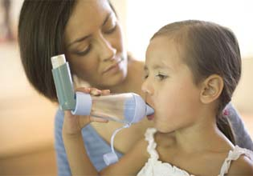

Fulton County, NY Demographics
    Population 55,456
Unemployment rate 9.3 %
14.5% families below Federal poverty level
Smoking rate 31%
# 5 NYS asthma hospital discharges
Medicare costs per capita=
Lowest Quartile (87% US median)

Slide 20
Services Unavailable at NLH
Major trauma
Interventional cardiology
Renal dialysis
Intensivists
Endocrinology
Transplant services
Infectious disease
Peds ICU and NICU
Vascular Surgery
Neurosurgery
Mental health services

Slide 21

Our Pros and Cons
PRO
CON
More nimble
Same staff for most initiatives
Longevity of workforce employment
P4P resources
Fiscal stability
Late change adopters
Same staff for most initiatives
Longevity of workforce employment
Initiative overload
Limited resources and scope

Slide 22
Hospital Acquired Conditions
One Event at a Time

Slide 23
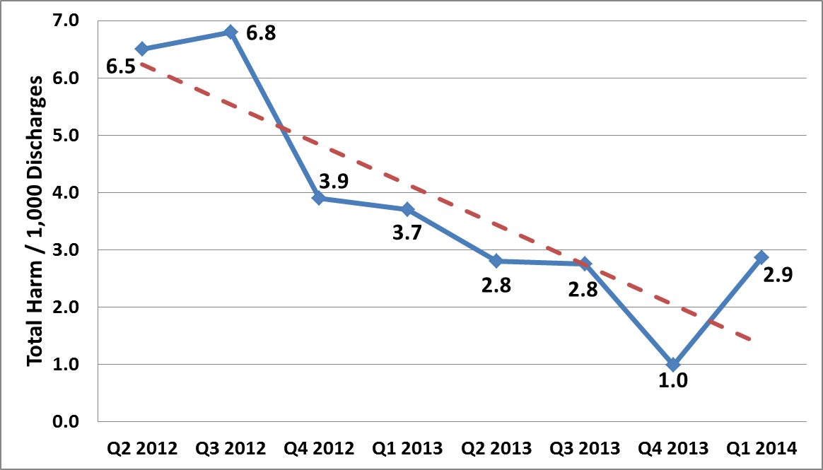
Harm Across the Board
Total Harm Events* per 1,000 Discharges

Slide 24
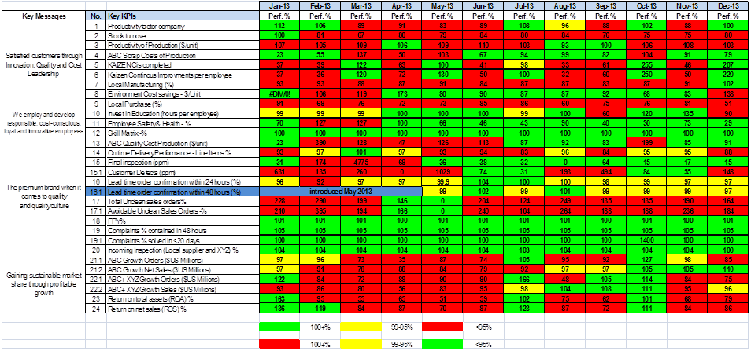

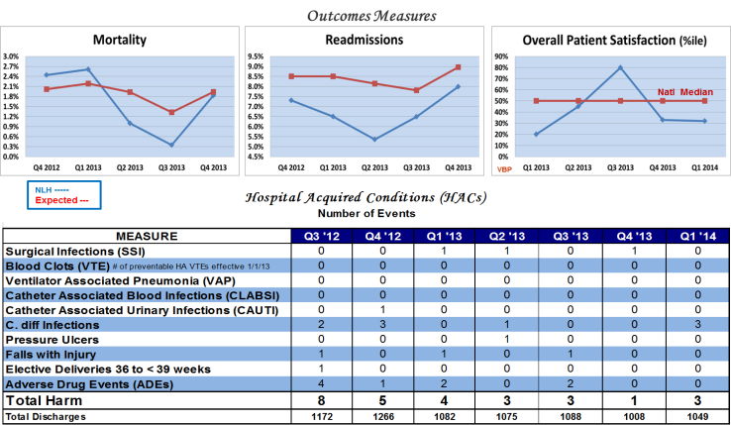
Getting the Board on Board
2009
Feb 2011
QPSS Report
Aug 2011

Slide 25
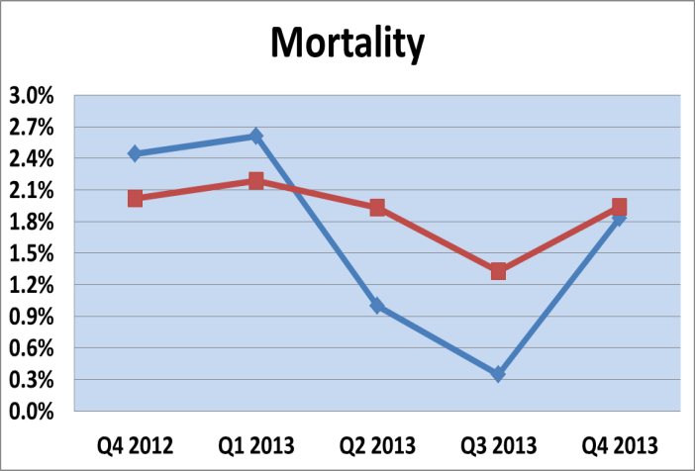
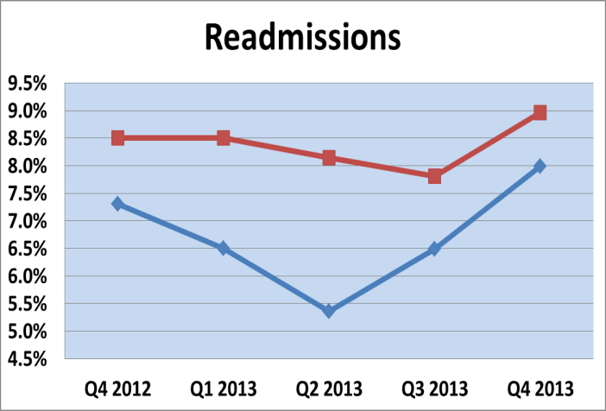
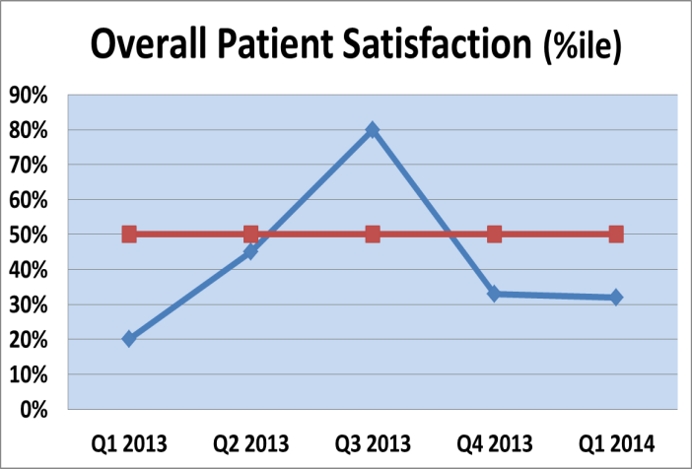
QPSS Report
A Report on Quality, Patient Safety and Satisfaction at Nathan Littauer Hospital
Outcomes Measures
Natl Median
VBP
NLH -----
Expected ---

Slide 26
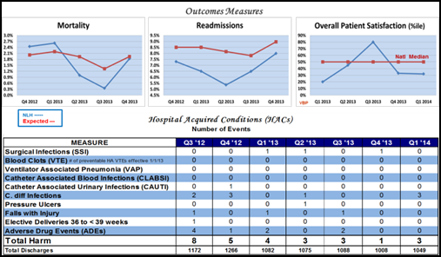
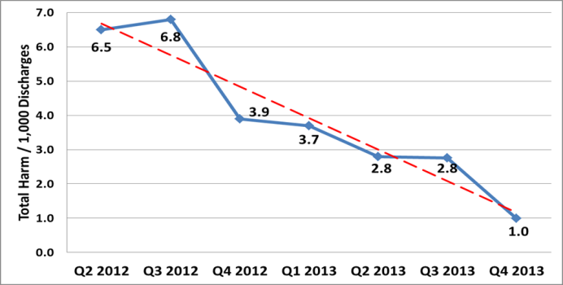
Getting the Board on Board
2009
Feb 2011
QPSS Report
Harm Across the Board
Aug 2011
Aug 2013

Slide 27

Engaging the Board
Data -Less is More
Goal – Zero Harm
Transparency
Educating the Board

Slide 28
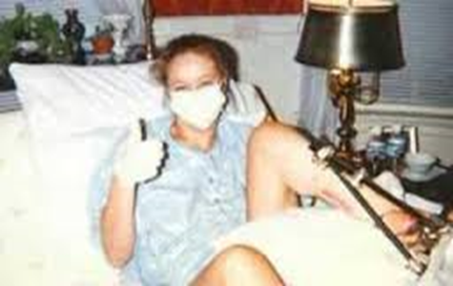

Engaging the Board
The Power of Stories
Accountability
Small Community – It’s Personal

Slide 29

Frederick Goldberg, MD MHCM
VPMA / Chief Medical Officer
fgoldberg@nlh.org

Slide 30
2014 Quality & Patient Safety Roadmap
Engaging the Board in
Safety and Quality
Beth Daley Ullem
Patient Advocate and Board Governance Expert
Board of Directors – ThedaCare
Former Board of Directors – Children’s Hospital of Wisconsin

Slide 31
Objectives
Build Board Engagement in Safety and Quality by:
  Understanding the Board’s Evolution, Composition, Responsibilities and Agenda and that of its safety and quality committee
  Educating and re-educating the Board on safety and quality
  Establishing accountability and transparency for safety and quality at the Board Level
  Creating regular Board engagement with the PFAC

Slide 32
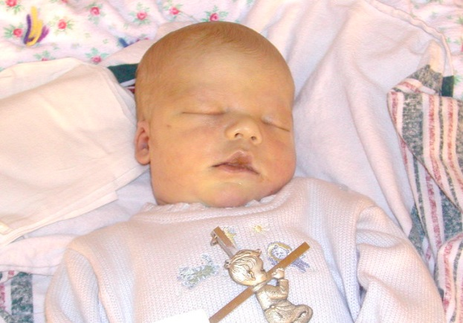
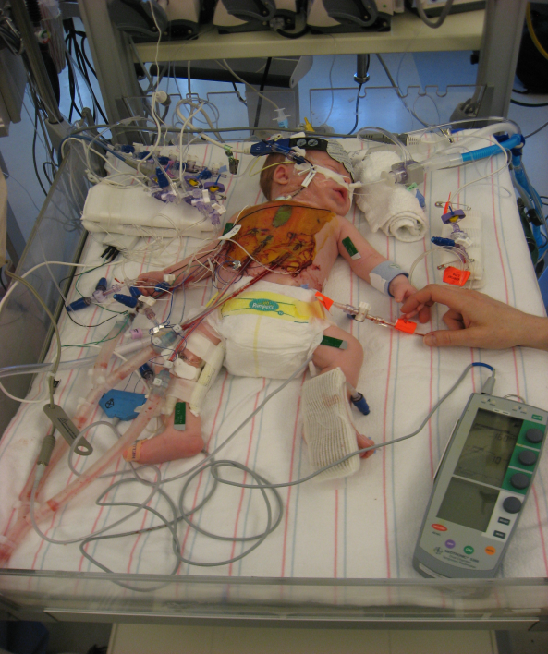
My Passion for Safety and Quality
…is Both Personal and Professional
Personal
  Lost my son Michael in 2003 to a preventable medical error at a major hospital
  My youngest son, Mac, is a medically complex ‘frequent flier’ in children’s hospitals with 36 surgeries to date

Slide 33
My Passion for Safety and Quality
…is Both Personal and Professional
Professional
  Serve on 2 major hospital system Board of Directors
  Work with a network of 81 pediatric hospitals to improve their Board Safety and Quality Engagement
  Run a foundation to advance and spread innovations in safety and quality and transparency of harm across the hospital systems
  Work to advance communication capabilities of medical staff after a harm event via education and training
  Speak nationally on board and patient engagement, medical errors and transparency of outcomes
  Employ my consulting background to advance the comparative analytics in the boardroom and role of safety and quality in the hospital strategy

Slide 34
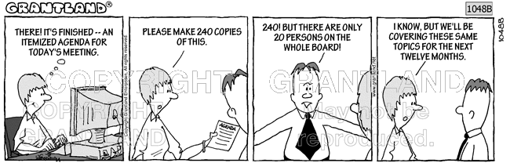

Understanding Your Hospital Board
Notes:
Educating board on the national changes and the impact at a local level.
Board retreats with medical staff and national speakers
Self assessments.

Slide 35
Understanding Your Hospital Board
Historical evolution of Boards
  Shift from philanthropic to governing boards
  Hospital Mergers and rapidly evolving industry increase complexity of oversight and a trend to focus on finance in the boardroom
  Inclination to view safety and quality as a clinical / staff issue, not always a board responsibility
Where does your hospital board fit in its evolution?
Notes:
Educating board on the national changes and the impact at a local level.
Board retreats with medical staff and national speakers
Self assessments.

Slide 36
Engaging Your Hospital Board
…I’m not sure about my board?
Gain a basic understanding of your board and its commitment to safety and quality
Evaluate board composition – skills and background
Understand board agendas and frequency of meeting
Analyze committee agendas and frequency of meeting
Review education for board members– on-ramp and ongoing
Board’s use of a comparative dashboard – if they don’t measure it, they don’t manage it!
Board is aware of serious harm timely and transparently
Interactivity of meetings and asking questions
Notes:
Educating board on the national changes and the impact at a local level.
Board retreats with medical staff and national speakers
Self assessments.

Slide 37
Engaging Your Hospital Board
…as a Safety and Quality Leader – how can I build the skills on my board to engage?
Expand board education
On-ramping new board members
  Comprehensive program that is content rich teaching the ‘why and how’, key terms and not just motivational
Ongoing education should be ‘hands-on’
  Med school 101
  Board joins rounds / M&M / RCA
  Use scenarios with real stories to illustrate concepts
Calibration – Using annual evaluation that assesses content knowledge (not ‘feel good’ contribution)
Notes:
Educating board on the national changes and the impact at a local level.
Board retreats with medical staff and national speakers
Self assessments.

Slide 38
Engaging Your Hospital Board
…as a Safety and Quality Leader – how can I help my board be accountable for their responsibilities?
Set expectations and offer tools for understanding and oversight
Establish an annual super-agenda that the board is expected to oversee and understand
Offer a comparative dashboard that is reviewed in-depth at committee level and focused on at Board meetings and highlights trends
Be transparent with harm and errors
Help the board establish a compensation structure for the hospital or SLT that will include safety and quality metrics
Provide opportunities to network with other boards and and learn best practices
Notes:
Educating board on the national changes and the impact at a local level.
Board retreats with medical staff and national speakers
Self assessments.

Slide 39
Engaging Your Hospital Board
…as a PFAC advisor – how can I help my board?
Bring the perspective of the patient into the Boardroom
  Create a representative patient face and name – so the patient is not talked about generically
  PFAC should report to the the Quality committee or the Board regularly and should be on the scheduled agenda
  PFAC’s role should extend beyond a ‘voice’ and instead also be a contributor and partner with clinicians and hospital administrators to solve problems, improve care and educate and enable patients – demonstrate voice and value!
Notes:
Educating board on the national changes and the impact at a local level.
Board retreats with medical staff and national speakers
Self assessments.

Slide 40
Engaging Your Hospital Board
Thoughts from Mother Teresa…
“Honesty and transparency make you vulnerable. Be honest and transparent anyway.”
Mother Teresa (1910-1997)
Founder Of The Missionaries Of Charity
Notes:
Educating board on the national changes and the impact at a local level.
Board retreats with medical staff and national speakers
Self assessments.

Slide 41
TWEET US @AHA_SLHQ #QualityRoadmap
Notes:
Resting slide

